Slide 1

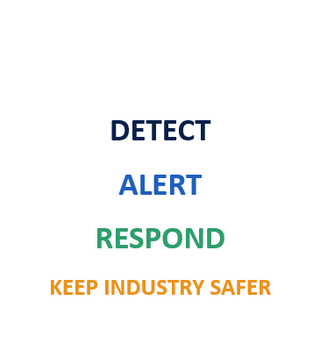
OPCODE IMPACT 2026
24-HOUR NATIONAL LEVEL HACKATHON
OT-SHIELD
Industrial IoT Cybersecurity Monitoring System
Detect • Alert • Respond • Keep Industry Safer
TEAM NAME
NEXORA
TRACK
IoT / Industrial Cybersecurity
9–10 OCTOBER 2026 • JYOTHI ENGINEERING COLLEGE
OPCODE IMPACT 2026 • Prototype presentation

Slide 2
1. Problem Statement
CHALLENGE
Industrial environments need fast detection of abnormal sensor behavior.
Problem
Existing Gap
Industrial control systems rely on sensor readings such as temperature, pressure, motor RPM, voltage and current. Unexpected or manipulated readings can indicate equipment faults or a simulated cyberattack.
Existing Gap
Many basic monitoring views show sensor values but provide limited anomaly explanation, threat severity, incident context, or recommended response in one place.
OT-SHIELD combines monitoring, threshold checks, alerting and incident details in a single dashboard.
Who is affected?
Why does it matter?
• Abnormal readings may signal risk
• Delayed response can increase downtime
• Operators need clear incident details
• Safer operations support sustainability
• Industrial operators
• Sensors and motor controllers
• Production equipment
• Plant operations and safety
Prototype uses simulated sensor values; real plant deployment needs further validation.
OPCODE IMPACT 2026 • 24-Hour National Level Hackathon
03

Slide 3
2. Proposed Solution
SOLUTION
A lightweight dashboard for monitoring industrial sensor anomalies and incidents.
OT-SHIELD
A Python-based prototype that simulates sensor readings, detects threshold violations, calculates threat severity and presents actionable alerts in Streamlit.
Detect
Protect
Respond
Sustain
Monitor sensor values and flag abnormal temperature, pressure, RPM, voltage and current.
Use predefined limits to identify suspicious or unsafe readings.
Show threat severity, incident details and recommended actions for operator review.
Support safer industrial operations and SDG 9: Industry, Innovation and Infrastructure.
Key Innovation
Key innovation: a simple, integrated view of sensor telemetry, anomaly detection, threat severity, incident history and planned Ntpy phone notifications.
OPCODE IMPACT 2026 • 24-Hour National Level Hackathon
04

Slide 4
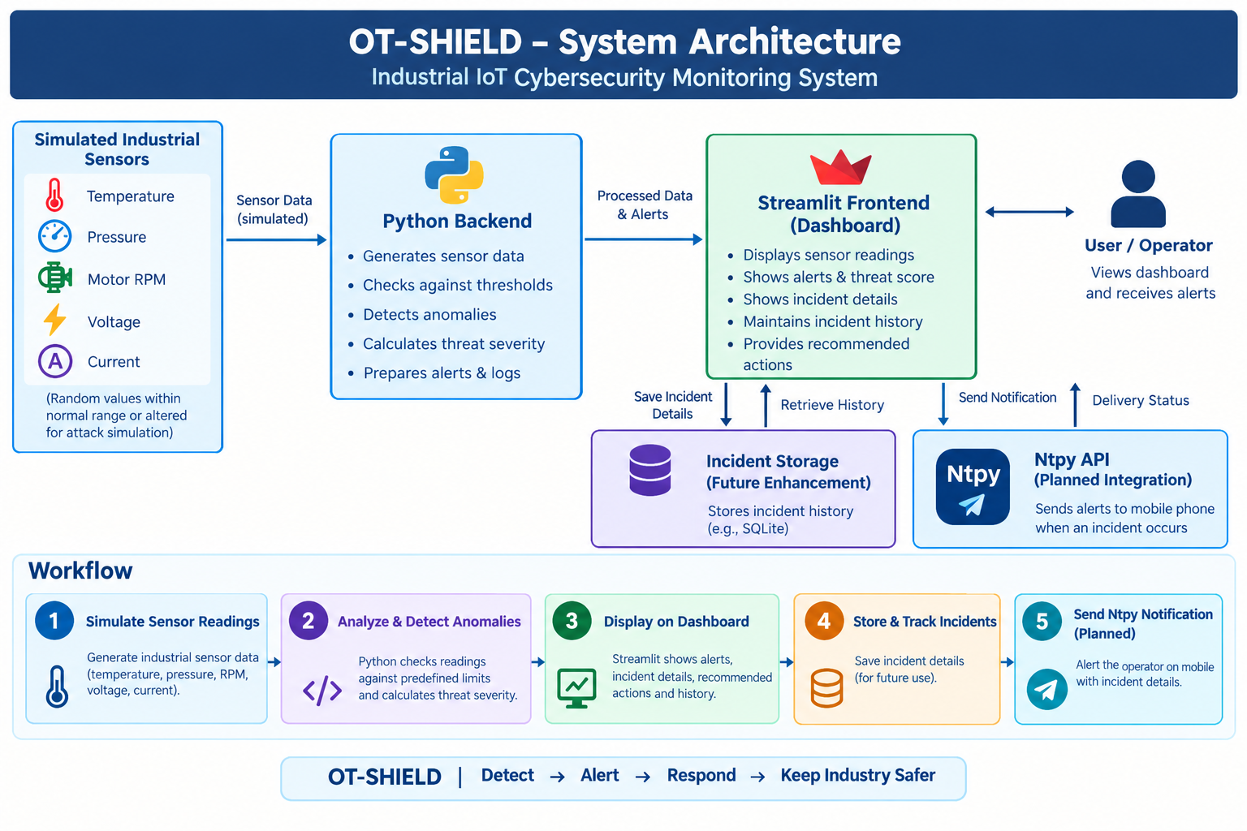
DATA / INPUT
PROCESSING
SECURITY
ENGINE
OUTPUT / ACTION
→
→
→
[Replace the blocks above with your actual components, technologies, APIs, databases, models, and trust boundaries.]
Threat / Trust Boundary
[Add data flow labels, encryption points, authentication, logging, or isolation controls here.]
3. System Architecture & Workflow
ARCHITECTURE
End-to-end data flow from simulated sensors to monitoring and operator notification.
OPCODE IMPACT 2026 • 24-Hour National Level Hackathon
05

Slide 5
4. Technology Stack & Security Design
ENGINEERING
Implementation choices and security considerations for the current prototype.
Technology Stack
Security Controls
Frontend: Streamlit dashboard
Backend / logic: Python
Sensor data: Simulated industrial readings
Storage: Incident history planned (e.g., SQLite)
Notifications: Ntpy integration planned
Detection: Threshold-based anomaly checks
Severity: Rule-based threat score
Operator action: Recommended response steps
Logging: Incident details shown in dashboard
Deployment: Prototype; not yet validated on live OT devices
Security-by-design checklist
✓
Least privilege
✓
Careful data handling
✓
Input validation
✓
Protect API credentials
✓
Incident traceability
✓
Test recovery paths
OPCODE IMPACT 2026 • 24-Hour National Level Hackathon
06

Slide 6
5. SDG Alignment & Societal Impact
IMPACT
OT-SHIELD supports more resilient and safer industrial operations.
Security Impact
Social / Environmental Impact
PRIMARY SDG
Flags out-of-range sensor readings
Provides threat severity context
Surfaces recommended operator actions
Helps organize incident information
Industrial operators benefit from clearer alerts. Earlier awareness may help reduce avoidable equipment disruption and support safer, more reliable operations.
SDG 9
Industry, Innovation and Infrastructure
Improves awareness of abnormal industrial sensor behavior and supports more resilient infrastructure through monitoring and incident response.
Impact Metrics
Current evidence: dashboard demonstrates normal readings and a simulated critical incident.
Metrics not yet benchmarked: detection accuracy, false-positive rate and response time.
Baseline: manual review → Prototype: automated threshold checks → Target: validated real-time monitoring
OPCODE IMPACT 2026 • 24-Hour National Level Hackathon
07

Slide 7
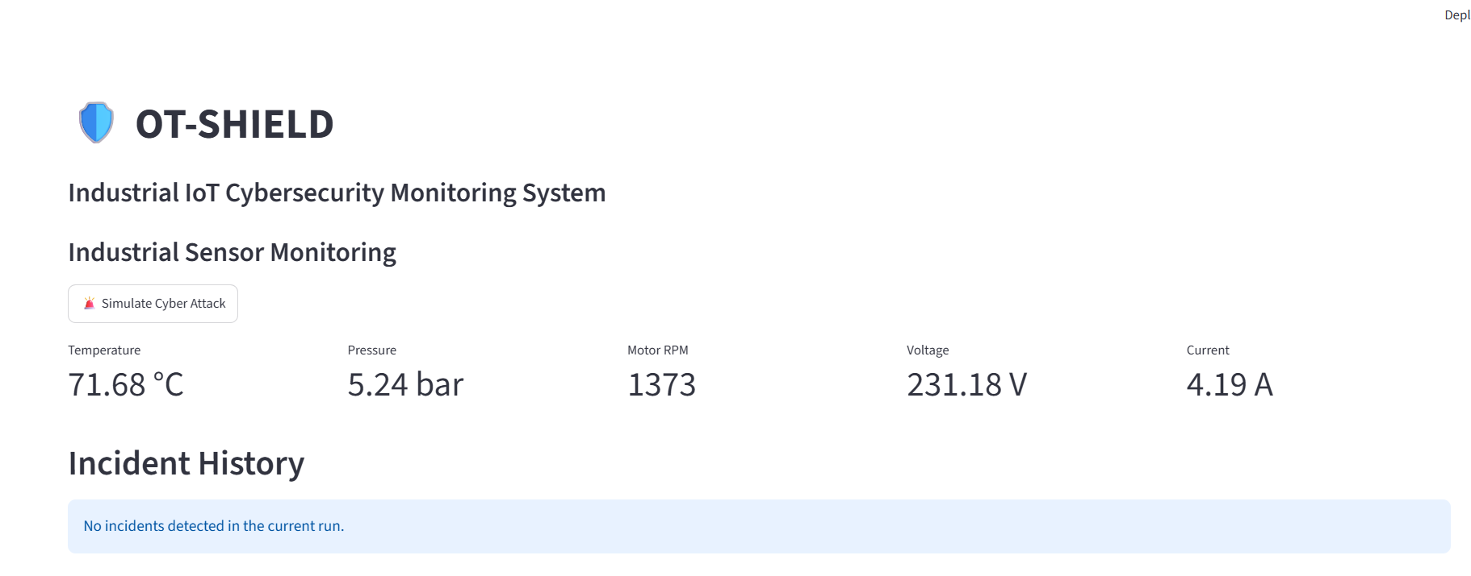
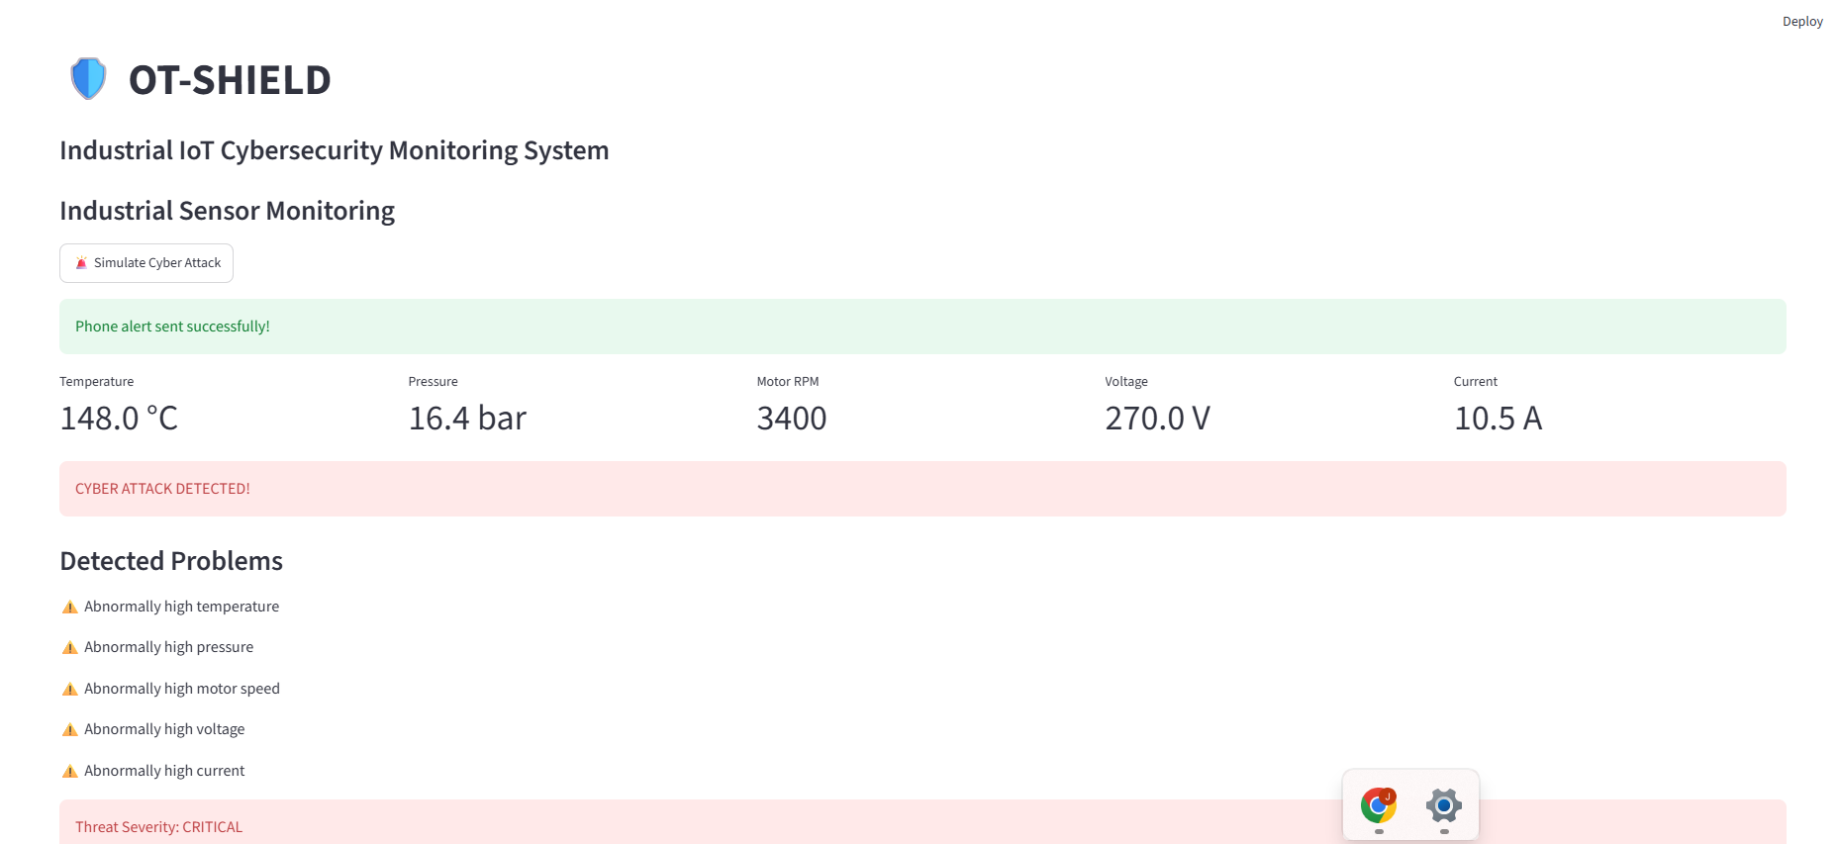
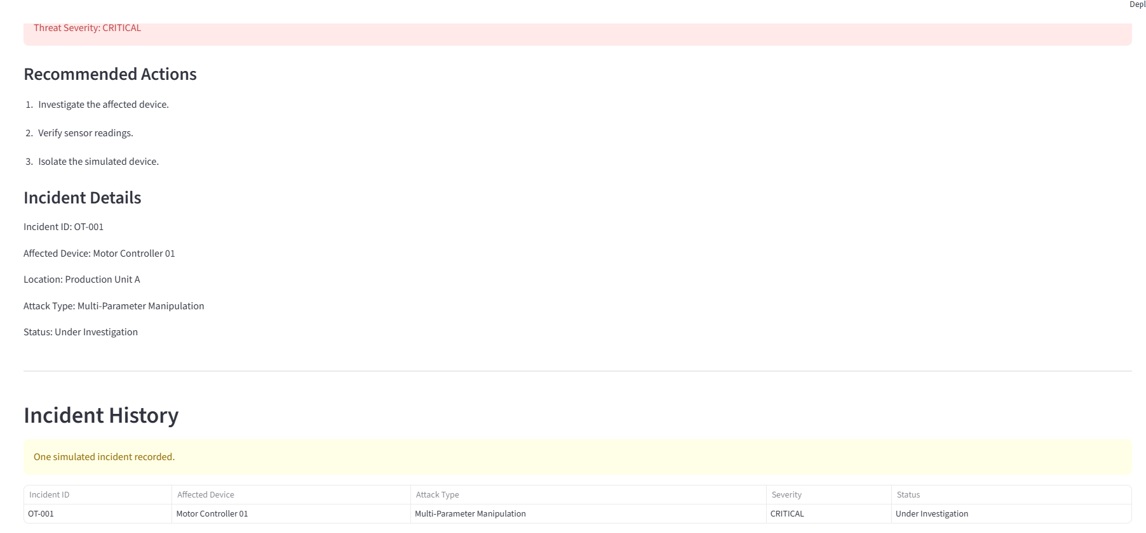
6. Prototype / Demo
DEMO
Dashboard evidence from normal monitoring and simulated attack scenarios.
NORMAL MONITORING
SIMULATED ATTACK
INCIDENT DETAILS
Sensor readings in normal range
Critical values trigger alerts
Threat level and response steps
Baseline dashboard
Detection and processing
Result / response
Demo Highlight
Demo highlight: clicking “Simulate Cyber Attack” changes sensor values, raises a cyberattack alert, lists detected problems, assigns CRITICAL severity and displays incident details and recommended actions.
OPCODE IMPACT 2026 • 24-Hour National Level Hackathon
08

Slide 8
7. Results & Evaluation
VALIDATION
Qualitative validation from the current simulated prototype.
Detection behavior
Response
Threat severity
Test environment
Threshold-based
Dashboard alert
CRITICAL shown
Simulated sensors
Test Setup
Limitations / Risks
Environment: Streamlit dashboard with Python-generated sensor values
Test cases: Normal readings and simulated multi-parameter manipulation
Observed output: abnormal temperature, pressure, motor speed, voltage and current are listed
Incident example: OT-001; Motor Controller 01; Production Unit A; status Under Investigation
• No formal accuracy benchmark yet
• Values are simulated, not live PLC/sensor data
• Threshold rules may need tuning per machine
• Ntpy delivery is shown as planned integration; validate end-to-end delivery before deployment
OPCODE IMPACT 2026 • 24-Hour National Level Hackathon
09

Slide 9
8. Future Scope
ROADMAP
Roadmap from a simulated demo toward a validated industrial monitoring tool.
NOW
NEXT
LATER
BEYOND
Prototype
Pilot
Scale
Impact
Python + Streamlit prototype
Sensor simulation
Threshold alerts and incident details
Connect real or replayed sensor data
Tune thresholds with domain experts
Test false positives and response time
Persist incident history in SQLite
Integrate and test Ntpy notifications
Add authenticated operator access
Pilot with isolated test equipment
Add audit logs and secure secrets
Evaluate resilience and SDG outcomes
Long-term vision: make industrial anomalies easier to detect, understand and respond to—without disrupting critical operations.
OPCODE IMPACT 2026 • 24-Hour National Level Hackathon
10

Slide 10
9. Team & Responsibilities
TEAM
Replace the placeholders with your actual team members and contact details.
👤
👤
👤
👤
MEMBER 01
MEMBER 02
MEMBER 03
MEMBER 04
JIYA CLARE GIGI
KRISHNA PRADHA C J
JOHN FRANCY
SEBIN JOHNY
Team Lead / Integration
Python Backend / Detection
Dashboard / UI
Testing / Documentation
Contact
Email: jiyaclare07@gmail.com | GitHub / Demo: https://github.com/jiyaclare23/NEXORA.git
OPCODE IMPACT 2026 • 24-Hour National Level Hackathon
11

Slide 11
THANK YOU
Secure Today, Sustain Tomorrow.
OT-SHIELD
Team: NEXORE • Track: IoT / Industrial Cybersecurity
OPCODE IMPACT 2026 | 9–10 October 2026 | Jyothi Engineering College (Autonomous)
Questions?

